Slide 1
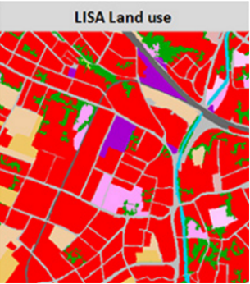
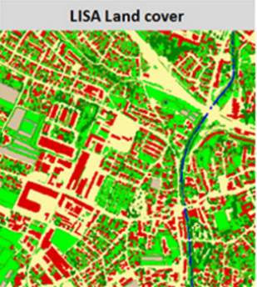
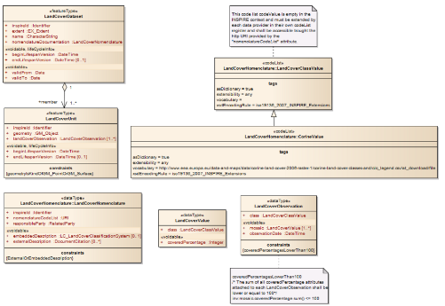
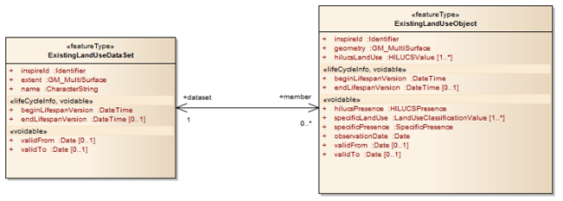
Modelling relationships Geometry constrains Voidable & multiplicity
Use Cases INSPIRE DS for Land Cover and Land USe
Roland Grillmayer 9.Dezember, Sydney

Slide 2
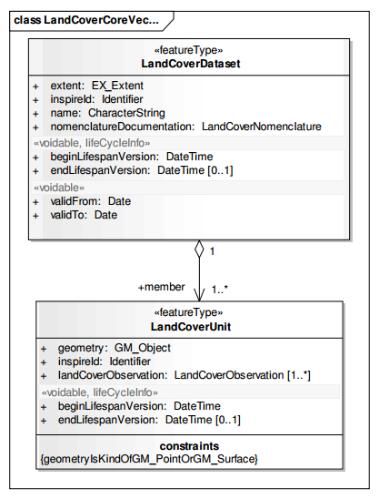
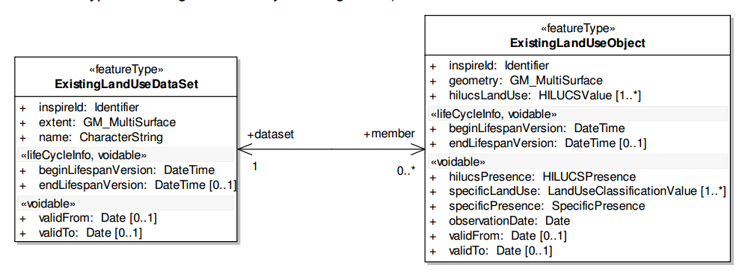
Modelling the relationship between dataset and dataset unit
INSPIRE DS on Land Use
INSPIRE DS on Land Cover

Slide 3
Modelling the relationship between dataset and dataset unit
The use of an association or a composition for modelling the same type of relationship in different domain models leads to
different xsd schemas and furthermore to c
completely different encoding of the GML instances
Association vs. Composition
Using a composition indicates a stronger binding/dependency
Level of dependency between dataset and data unit should be domain unspecific.
Recommendation for using which type for which cases?

Slide 4
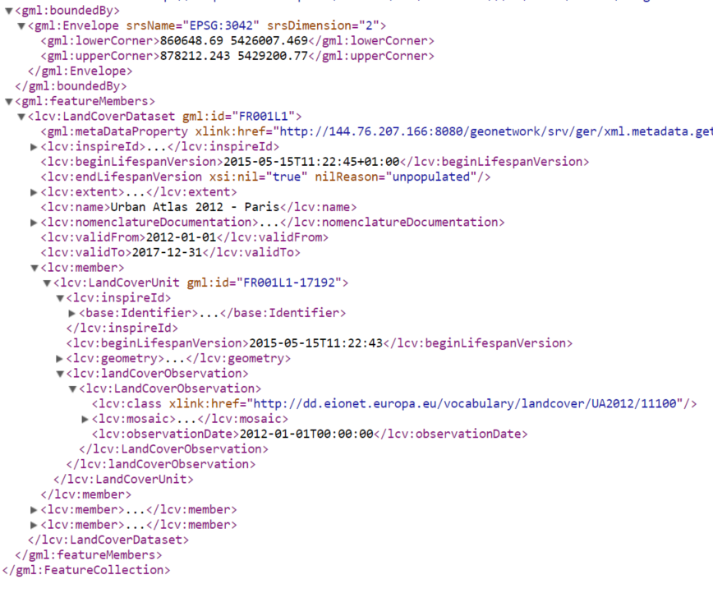
Modelling the relationship between dataset and dataset unit
Feature Collection has only one Feature Member
„Nesting“ of the <lcv:LandCoverUnit> within the <lcv:LandCoverDataset>
Many GIS-Clients could not render the nested geometry from <lcv:LandCoverUnit>
INSPIRE DS
on Land Cover

Slide 5
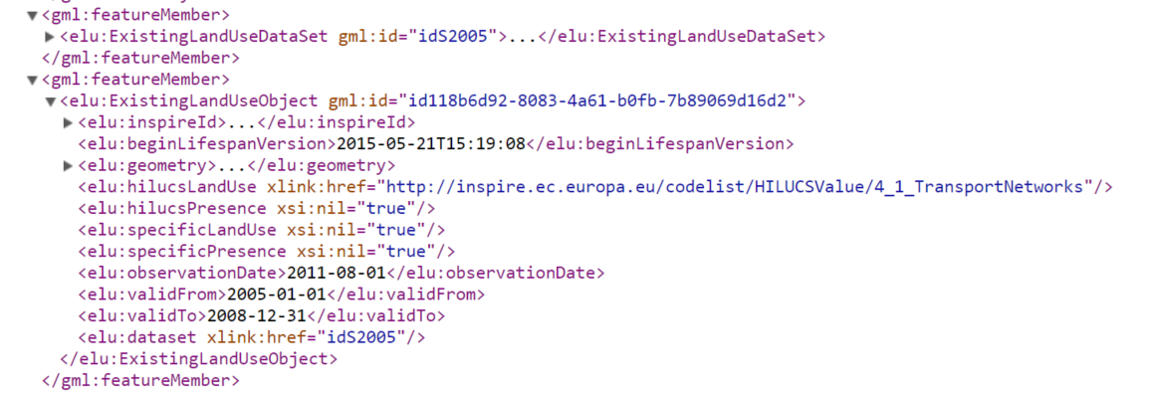
Modelling the relationship between dataset and dataset unit
Each <elu:ExistingLandUseObject> is represented as an FeatureMember of the FeatureCollection
User-friendly approch because most of the GIS-Clients have no problems to render the geometry
INSPIRE DS
on Land Use

Slide 6
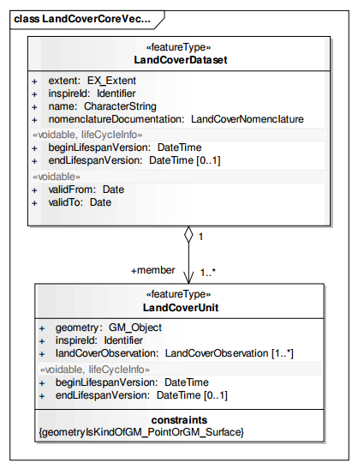
Best Practise for geometry constrains? 1.) Using a constraint
GM_Object with constraint geometryIsKindOfGM_PointOrGM_Surface
Many LC datasets have geometries of the geometry type GM_Multisurface ☹.
GM_Mutisurface is missing
FME transforms geometry with geometry type GM_Multisurface while the transformation process (constrains are not available on schema level)
INSPIRE DS
on Land Cover

Slide 7
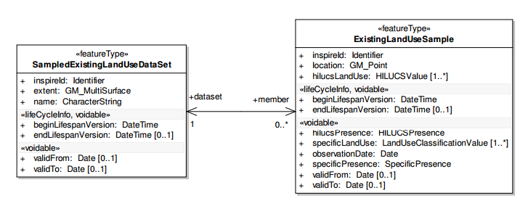
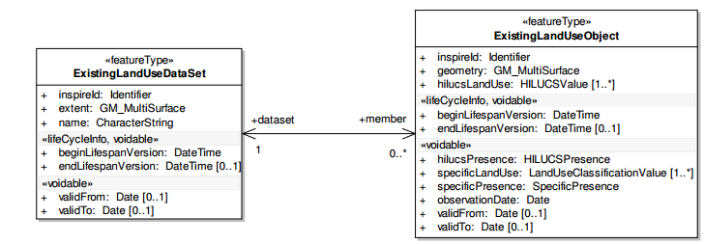
Best Practise for geometry constrains? 2.) Second identical schema – only geometry type changes
Complete identical application schemas
Only the location property uses different geometry type
Right way to model different geometry types or should the geometry type be constrained (like for LC)?
INSPIRE DS
on Land Use

Slide 8
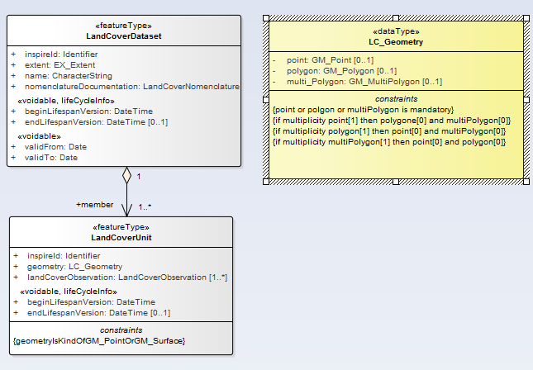
Best Practise for geometry constrains? 3.) Create an own geometry data type?
Available on schema level!
Software like FME could recognize/verify the geometry type while the transformation process

Slide 9
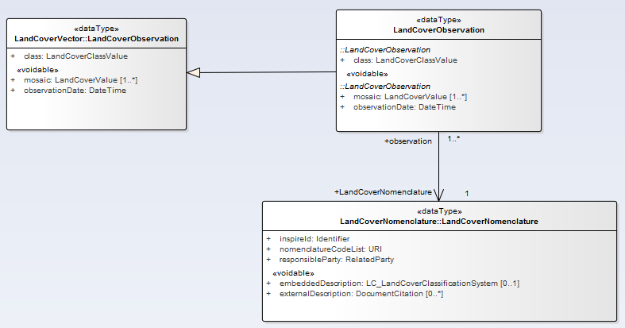
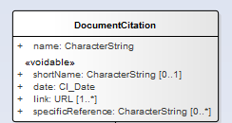
Viodable vs. multiplicity 0 Voidable feature properties within complex data types with multiplicity 0

Slide 10
Contact
Roland Grillmayer
Roland.grillmayer@umweltbundesamt.at
Austrian Environment Agency www.umweltbundesamt.at
Ad hoc group on best practices for UML modelling in ISO/TC 211
Sydney ■ 9 Dezember 2015

